Slide 1

Migration of Labview into the Test of Magnetic Properties
Supervisor: Prof. Dr.-Ing H. Förschner
07.11.26

Slide 2
Contents
Information about the experiment
Information about the project (task)
Current state
Next steps
Technical challenges
Benefits of the project
Hochschule Esslingen

Slide 3
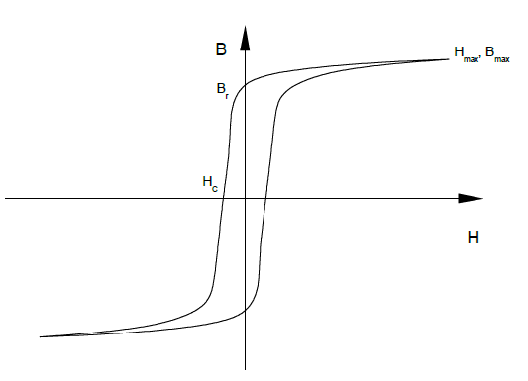
Information About the Experiment
Test of magnetic properties
Lab experiment is for students of the field of mechatronics
Hochschule Esslingen
Notes:
Test of magnetic properties includes getting the remanence value, the coercivity and the power dissipation of the magnetization-process for example

Slide 4
Information About the Project (Task)
Transfer the old system into a new designed environment with slightly other hardware
Implementation of the existing Pascal-Code using LabView
Optimization of the system regarding controlling and visualization
Hochschule Esslingen
Notes:
Optimize the system regarding controlling and visualization: Improve several different adaption processes of the oscilloscope and the frequency generator

Slide 5
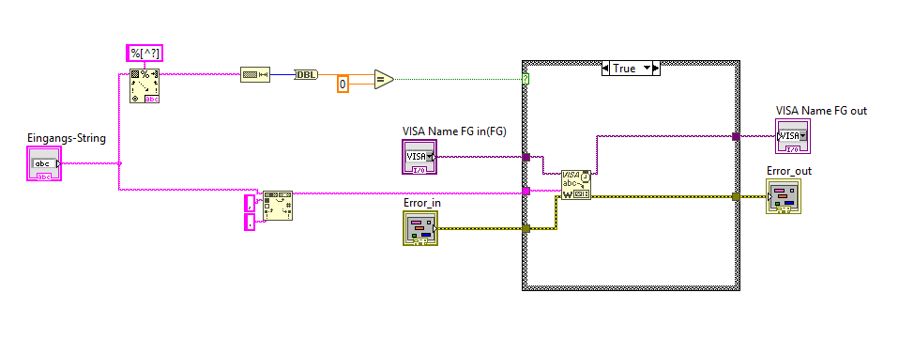
Current State
Software-Hardware-Comunication is finished
Hochschule Esslingen

Slide 6
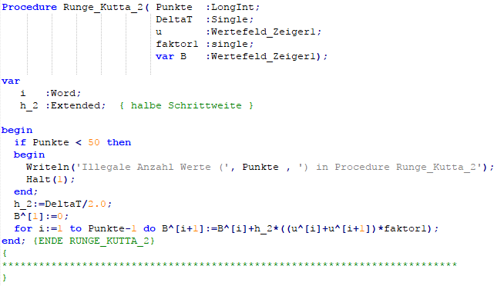
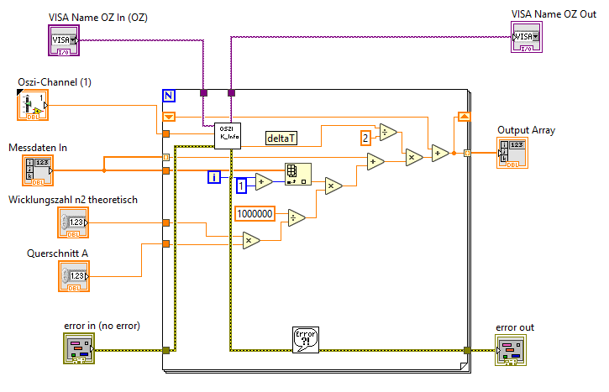
Current State
Translation of the old Pascal-Code to LabView-Code is in process
About 90% is already finished
Hochschule Esslingen

Slide 7
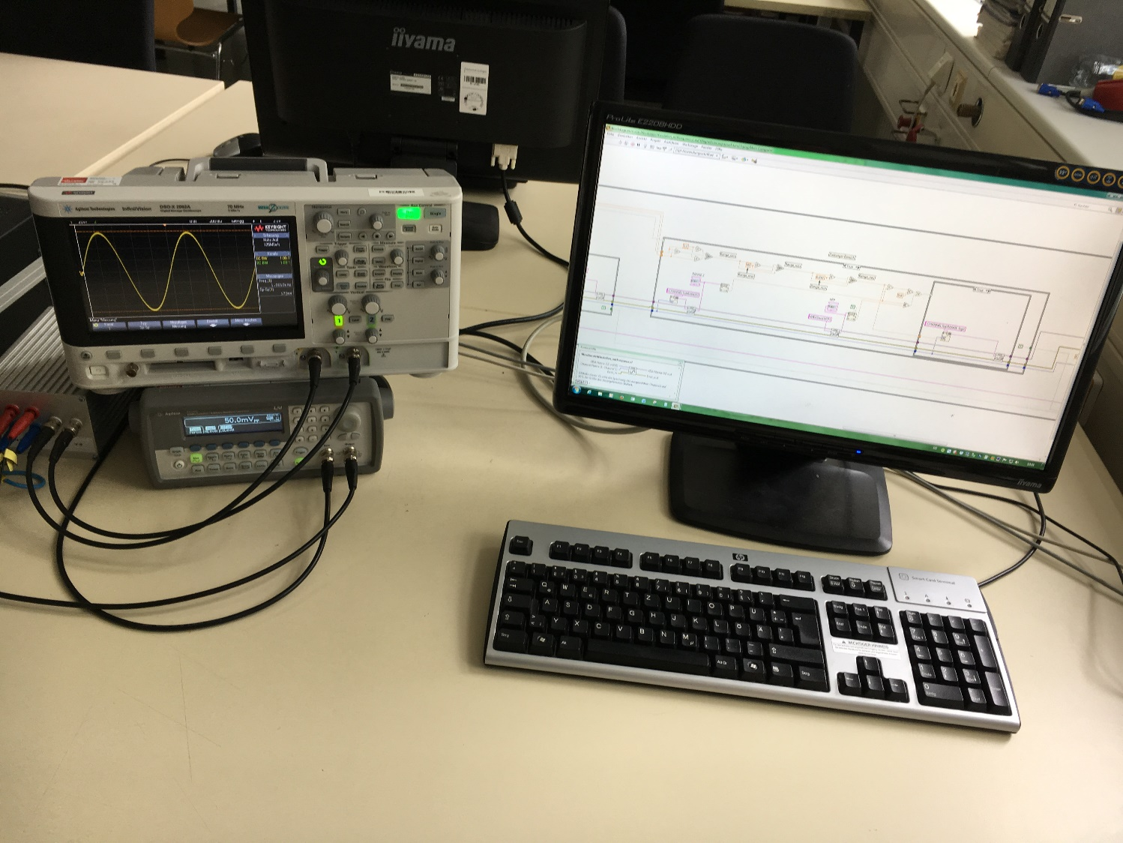
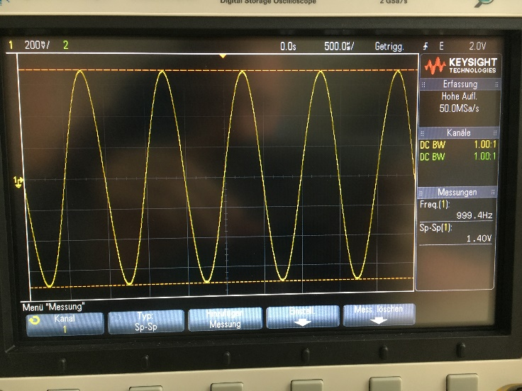
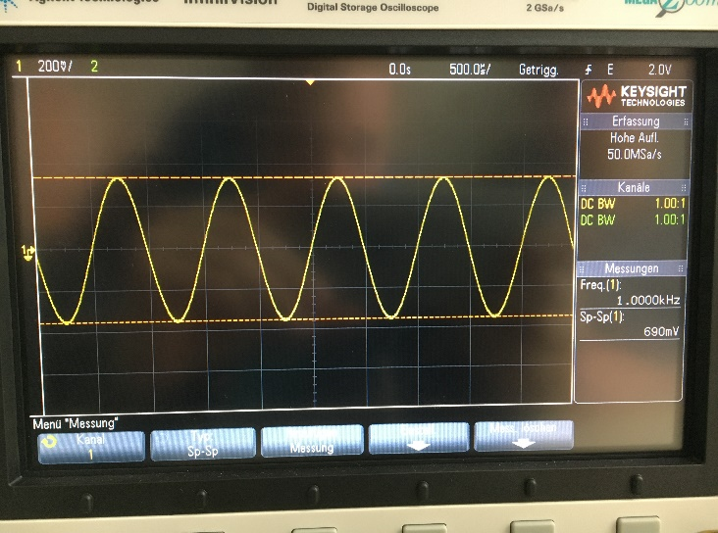
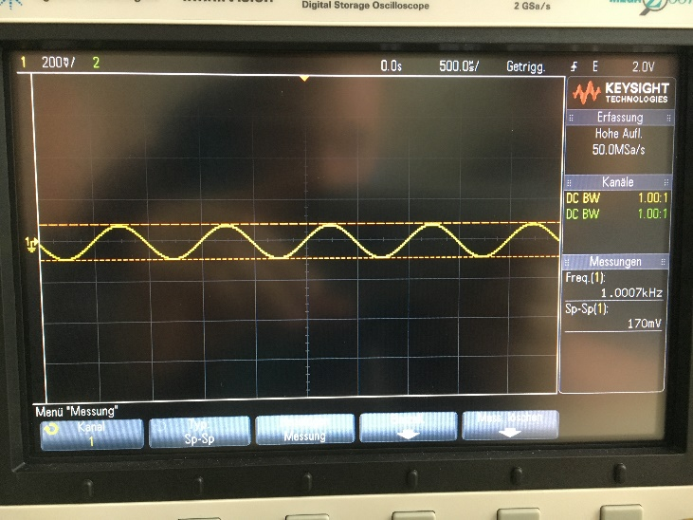
Current State
Some of the single software modules are already tested
Example: Testing the controlling of the frequency generator
Hochschule Esslingen
Notes:
Import picture testing the module for controlling the frequency generator: Here we can see the process of demagnetization

Slide 8
Next Steps
Finish the migration into LabView
Testing (of all single software modules)
Implementation of a state machine
Testing the whole system with „real“ hardware
Optimization
Hochschule Esslingen

Slide 9
Challenges
Technical:
Learning/Understanding of new programming languages
  LabView
  Pascal
Hardware-Software-Communication
  Importing measurement data
Generating plots with LabView
Hochschule Esslingen

Slide 10
Challenges
As a Team:
Working on a complex project
  Communication
  Organization and distribution of work loads
Hochschule Esslingen

Slide 11
Benefits of the project
Learning of new programming languages
  Pascal
  LabView
Software development in a team
  Development with SCRUM
  Team management (Trello etc.)
Hochschule Esslingen

Slide 12
Thank you

